Slide 1
Name, Bindings and Scope
Sabrina Tarin Chowdhury

Slide 2
Scope, Defined
Scope: Range of statements where a variable can be referenced or assigned (visible)
A variable is local to a function/method if it is declared there

Slide 3
Variable Attributes – Scope
The local variables of a program unit are those that are declared in that unit
• The nonlocal variables of a program unit are those that are visible in the unit but not declared there
• Global variables are a special category of nonlocal variables – visible to whole program
Two types of scopes – static and dynamic

Slide 4
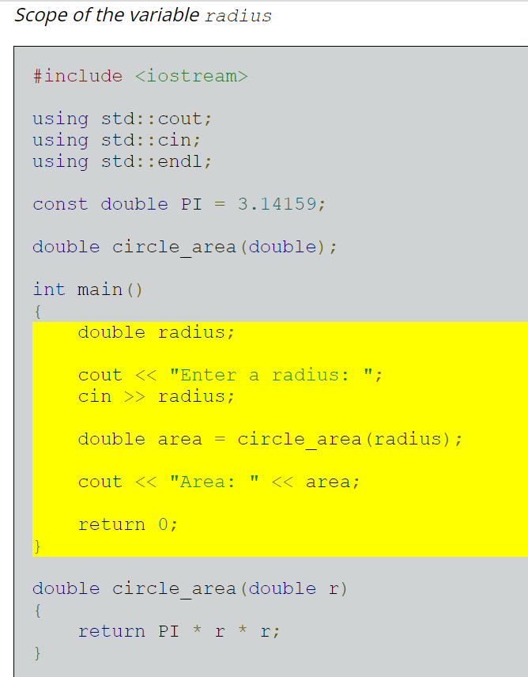
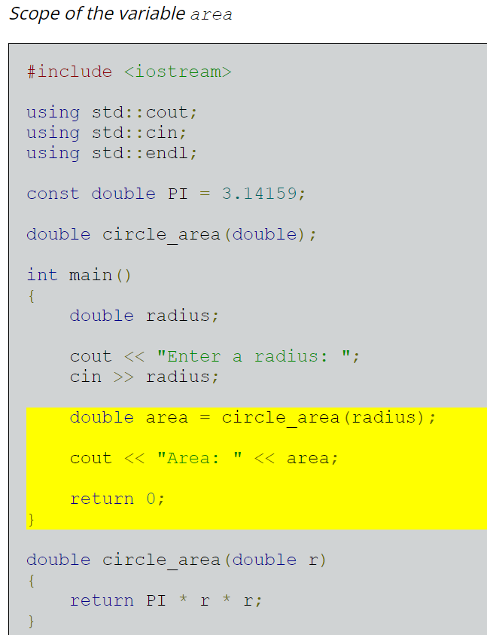
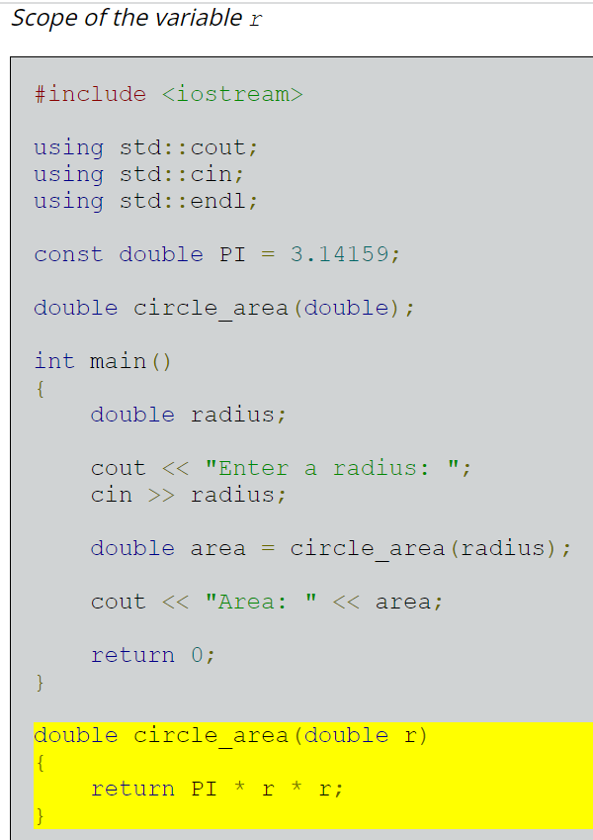
Example

Slide 5
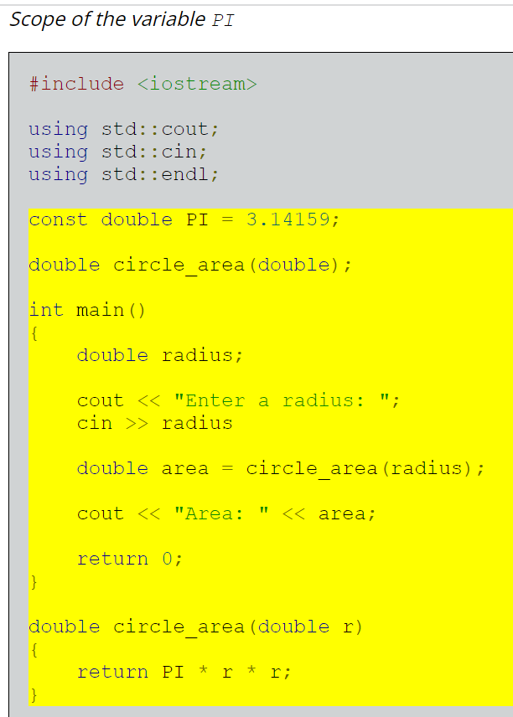
Example

Slide 6
Static Scope
Scope of variables can be determined statically
– by looking at the program
– prior to execution
– Based on program text
– To find the scope of a variable, search for the variable declaration
Scope Search process:
– search declarations,
• first locally,
• then in increasingly larger enclosing scopes,
• until one is found for the given name

Slide 7
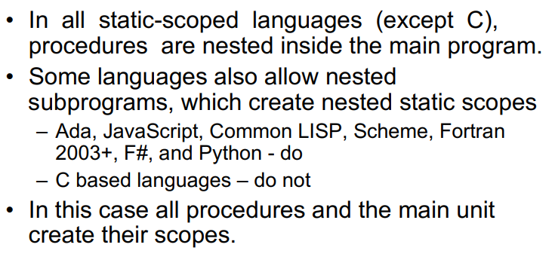
Static Scope

Slide 8
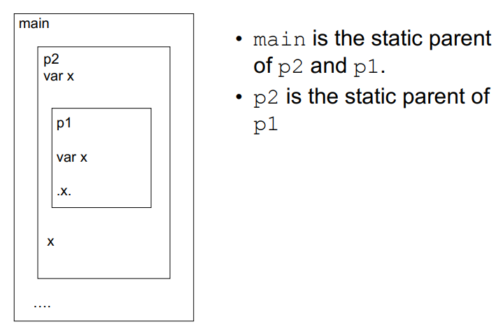
Static Scope

Slide 9
Static Scope
What is the scope of x in the following program?
JavaScript:
function big() {
function sub1() {
var x = 7;
sub2();
}
function sub2() {
var y = x; //scope of y? x?
}
var x = 3;
sub1();
}

Slide 10
Static Scope
function big() {
function sub1() {
var x = 7;
sub2();
}
function sub2() {
var y = x;
}
var x = 3;
sub1();
}
Notice a few things:
In sub2, x is not defined
Therefore, it checks its static parent (big), finding x = 3
x in sub1 is ignored because it is not in its static ancestry

Slide 11
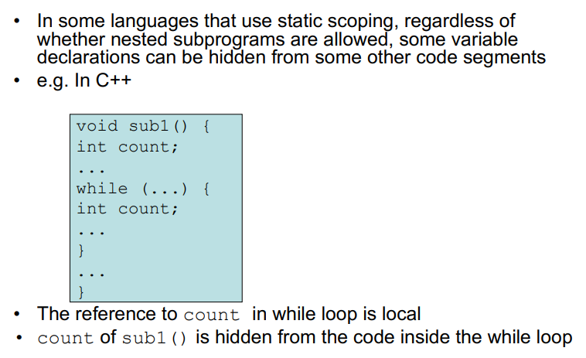
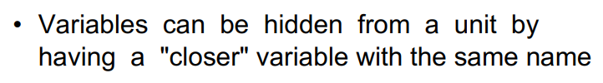
Static Scope

Slide 12
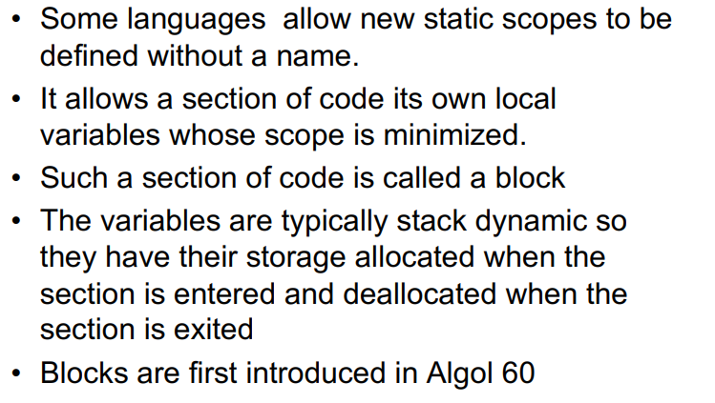
Blocks

Slide 13
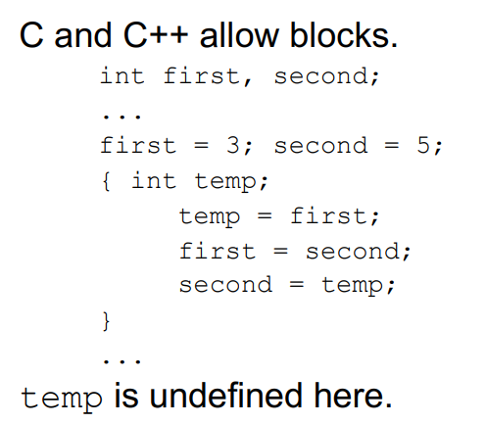
Blocks
In C++, a variable declared within the second curly braces are available only after declaration till the end curly brace.
Block

Slide 14
Declaration Order
Some languages require all declarations to be at the beginning of a function (like in C)
Java, C++, JavaScript, C# (and others) allow declarations anywhere a statement can appear in a program unit

Slide 15
Declaration Order, C#
C# does not allow reusing variable names in nested blocks
Scope of a declaration is the whole block
{int x;
…
{int x; //Illegal
…
}
…
}
Scope of x

Slide 16
Declaration Order, C#
{
{int x; //Illegal
…
}
int x;
}

Slide 17
Global Scope
Global variables: declarations appear outside of functions
Allowed in C, C++, PHP, JavaScript, Python
Various rules about how these variables can be accessed

Slide 18
Global Scope, PHP
PHP:
$day = “Monday”; //scope?
$month = “January”;
function calendar() {
$day = “Tuesday”; //scope?
global $month;
print “local day is $day “;
$gday = $GLOBALS[‘day’];
print “global day is $gday <br \>”;
print “global month is $month “;
}
calendar();
In PHP, any variable declared outside of a function is implicitly global
Also in PHP, one can use the $GLOBALS array to get access to them
Also in PHP, we can prepend the word global to make a variable so

Slide 19
Evaluation of Static Scoping
Advantages:
Works well much of the time
Disadvantages:
Allows more access to variables than is necessary
Programs evolve over time, structure changes and it becomes difficult to figure out what variables are used where
Solution: Encapsulation

Slide 20
Dynamic Scope
Dynamic scoping does not care about how the code is written, but instead how it executes.
Each time a new function is executed, a new scope is pushed onto the stack.
In dynamic scoping
– scope is based on the calling sequence of subprograms
– not on the spatial relationships
– scope is determined at run-time

Slide 21
Dynamic Scope
big()->sub1()->sub2()
function big() {
function sub1() {
var x = 7; //scope of x?
sub2();
}
function sub2() {
var y = x; //y=7
var z = 3;
}
var x = 3;
sub1();
}
big()->sub2()
function big() {
function sub1() {
var x = 7; //scope of x?
}
function sub2() {
var y = x; //y=3
var z = 3;
}
var x = 3;
sub2();
}

Slide 22
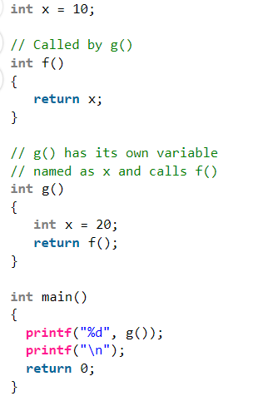
Static Vs Dynamic Scope
Static scope : Prints 10
Dynamic scope : Prints 20

Slide 23
Evaluation of Dynamic Scoping
Advantages:
Easier to pass variables
Disadvantages:
Less reliable than static scoping (can’t type check)
Harder to read
Slower to execute
Static scoping is much more widely used.

